Slide 1
good and bad graphs
(but mostly bad)

Slide 2
your graphs are terrible!
but don’t feel bad—ours are too

Slide 3
Documentation
Mostly Astro 331 student homework from 2023 Spring
Also!
Lesson slides from Astro 310
Lesson slides from Astro 331

Slide 4
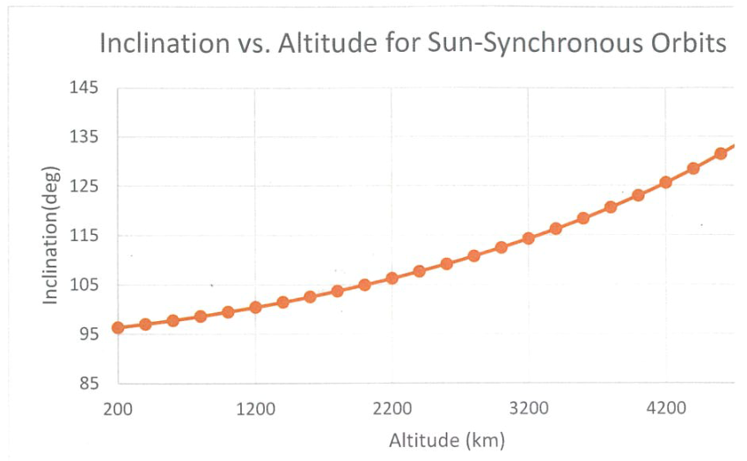
Excel default
Thick lines and markers bad
There are a few things wrong with this plot
Spurious outline of plot area
No end marker or altitude label on right—looks like it just didn’t print
No space between inclination(deg)
10 degrees of wasted vertical space (directions said not to do that)
Mostly, it’s here for the hideous markers and thick line—do they add anything?
Is this just a personal preference?
Notes:
There are a few things wrong with this plot
Spurious outline of plot area
No end marker or altitude label on right—looks like it just didn’t print
No space between inclination(deg)
20 degrees of wasted vertical space (directions said not to do that)
Mostly, it’s here for the hideous markers and thick line—do they add anything? Is this just a personal preference?
Is this just a preference?

Slide 5
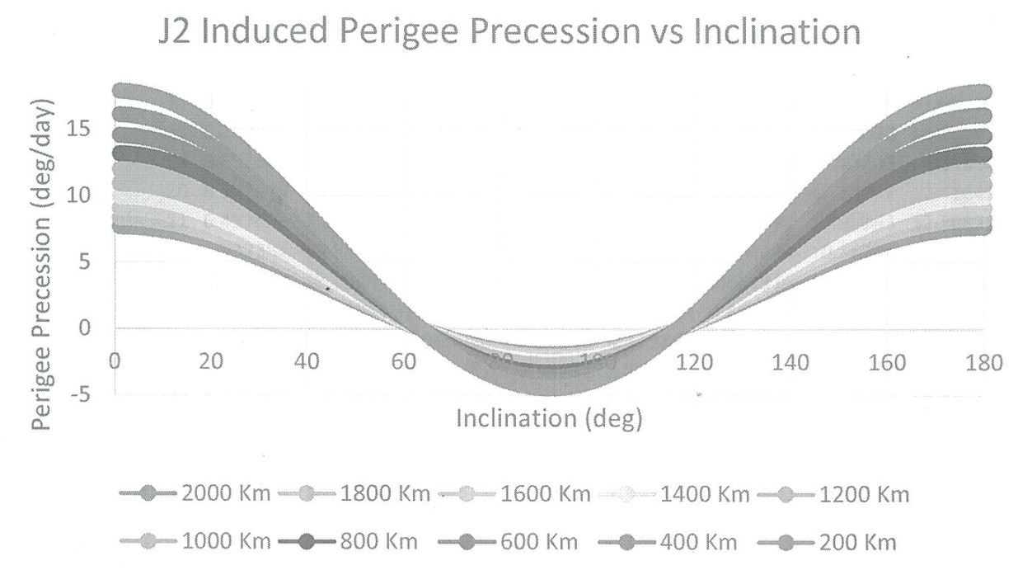
Excel default
Oh no!!
I can’t see which color is which
Even if I could, the lines are fat and cover each other
Don’t use thick lines
You probably don’t need markers at all

Slide 6
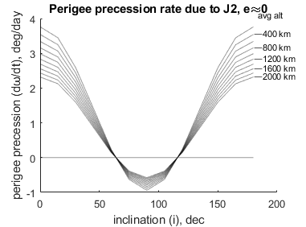
Low resolution
Not enough data for a smooth curve (Nobody made this mistake!)
Bitmap image formats don’t scale
This was png
I intentionally made it worse than usual

Slide 7

Low Resolution
It could be worse
compressed bitmap (jpg)
For functions (including data fit lines) use enough points to make a smooth curve
for real data, use unconnected dots
Use vector graphics (svg, pdf) if possible
If necessary, use bitmaps (gif, png)
Reserve jpg only for photographs

Slide 8
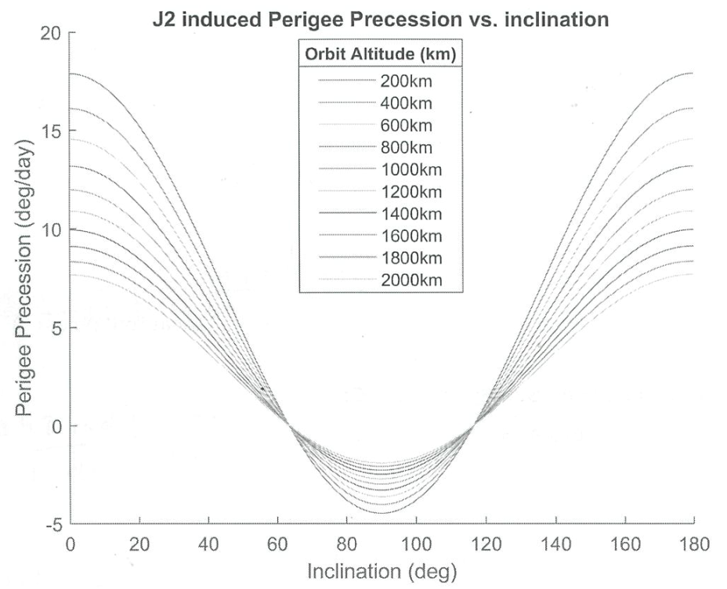
Ambiguous color
I can’t distinguish between the lines
BW/grayscale is fine if done correctly
(also no space between alt and “km”)

Slide 9
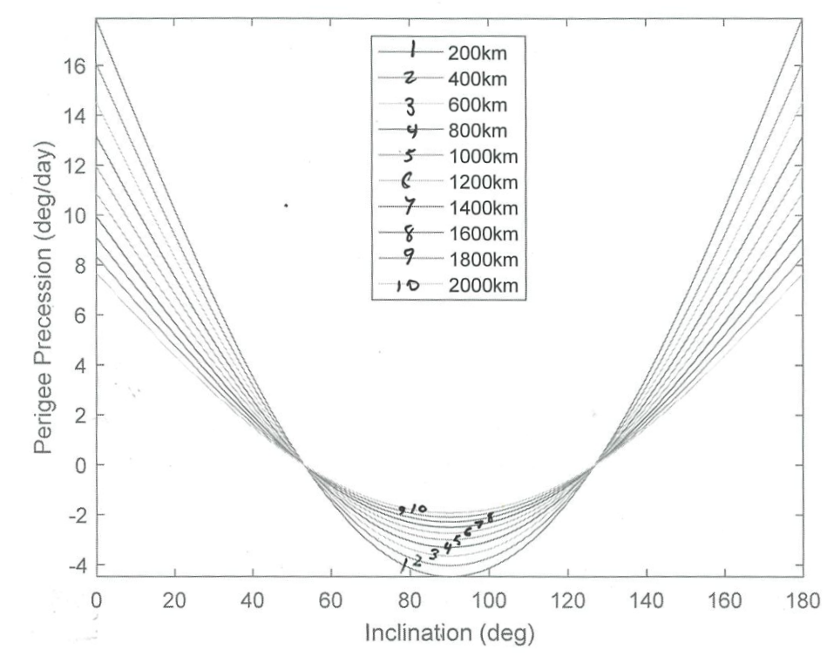
Hand-drawn markers
This is one way to fix the BW/grayscale problem
Combining printed graphics and hand-drawn numbers looks sloppy
This one also has wrong data—slope should be continuous at 0/180 deg

Slide 10
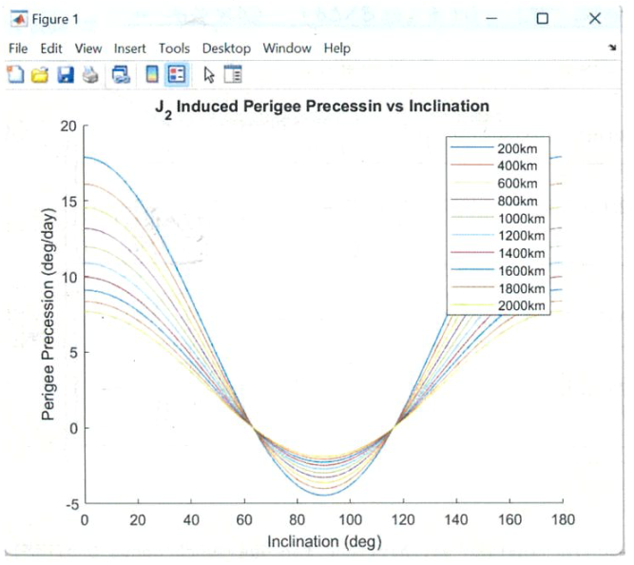
Screenshot and legend overlap
First, note the legend overlapping the data
Next, the figure window
This is faster, but communicates laziness
Wastes space and attention
Screenshot has limited resolution
At least use win-shift-s (snipping tool)
Real fix: file -> save as -> (svg)

Slide 11
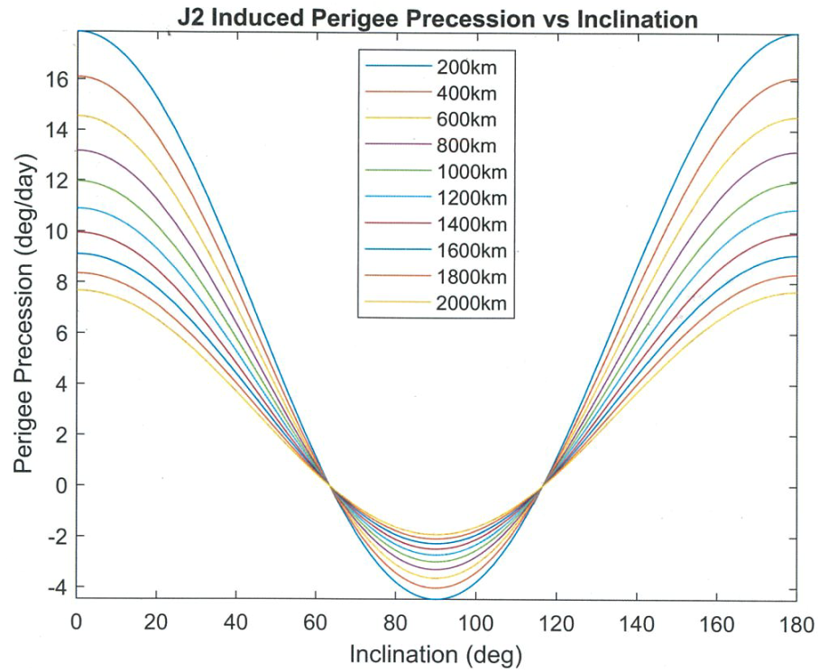
Color lines
Thin color lines are clear except…
There are multiple blues, reds, and yellows
Even if each of these colors was unique…

Slide 12
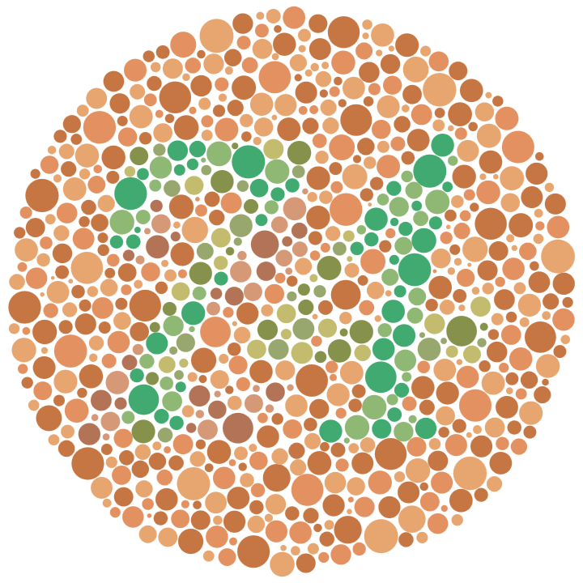
Color-blindness!
Red-green color-blindness is a recessive genetic trait
Prevalence:
8% of males
0.5% of females
(x-linked)
Males cannot be carriers
Females can be carriers
Don’t assume your audience is trichromatic
Notes:
Normal: 74
red-green colorblind: 21

Slide 13
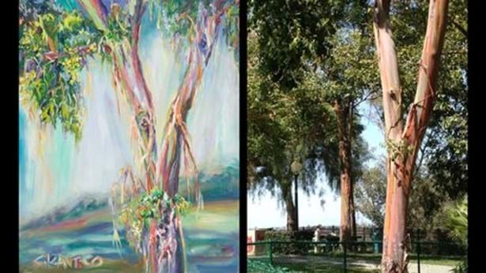
Tetrachromacy
Red-green colorblind carriers (who are all females) may be tetrachromats (see four colors vs the usual 3)
“Antico also notes that she can detect when someone is ill due to the colour of their skin, and also noticed when her baby daughter was jaundiced due to a yellow tinge to her skin, even before doctors had realised she was suffering with it!”
Notes:
https://www.optimax.co.uk/blog/tetrachromacy-superhuman-vision/

Slide 14
Color-blindness
Red-green confusion colors
Cyan and Grey
Rose-Pink and Grey
Blue and Purple
Yellow and Neon Green
Red, Green, Orange, Brown

Slide 15
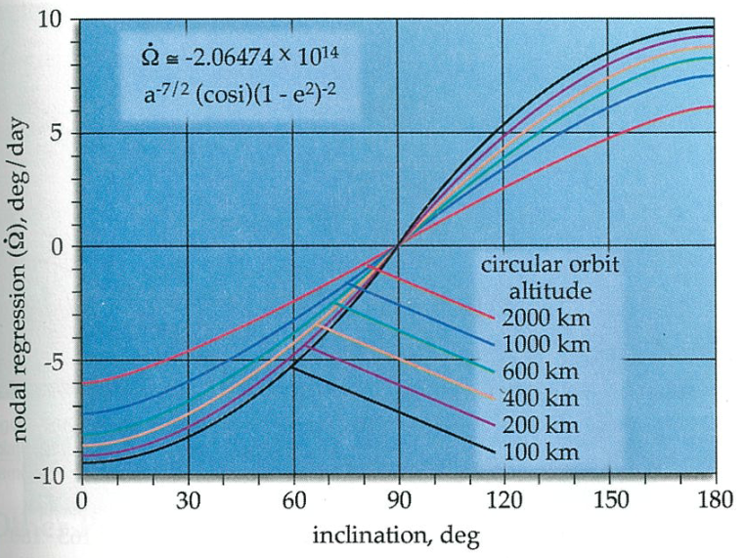
Understanding Space
Pretty good!
Labels > legends
Labels make red/green ok
Everything labelled clearly
I like the included equation
(title is in the figure’s caption)
Bad:
Color background
Grid lines

Slide 16
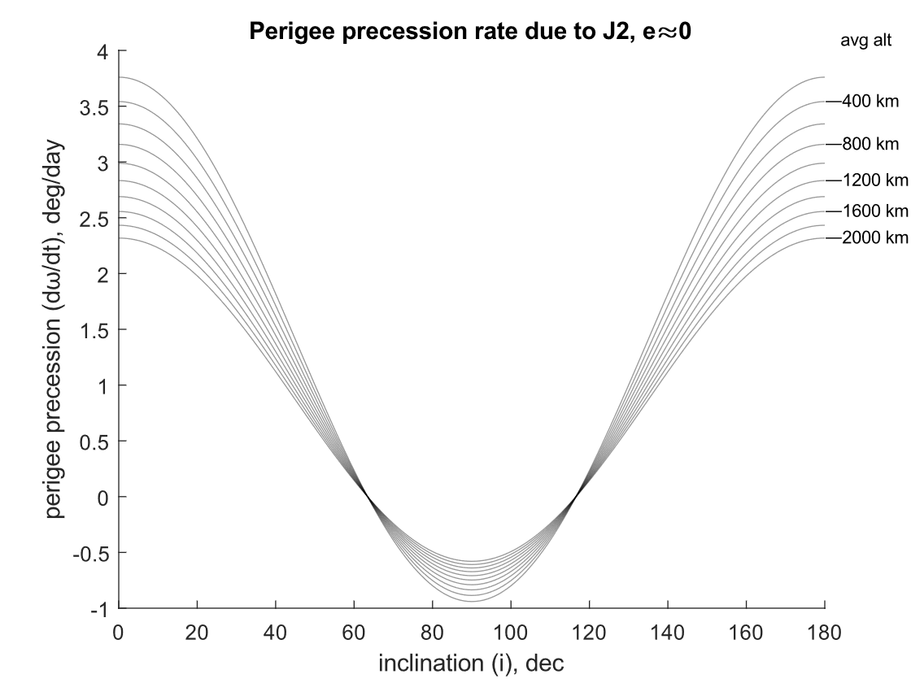
Proposal

Slide 17
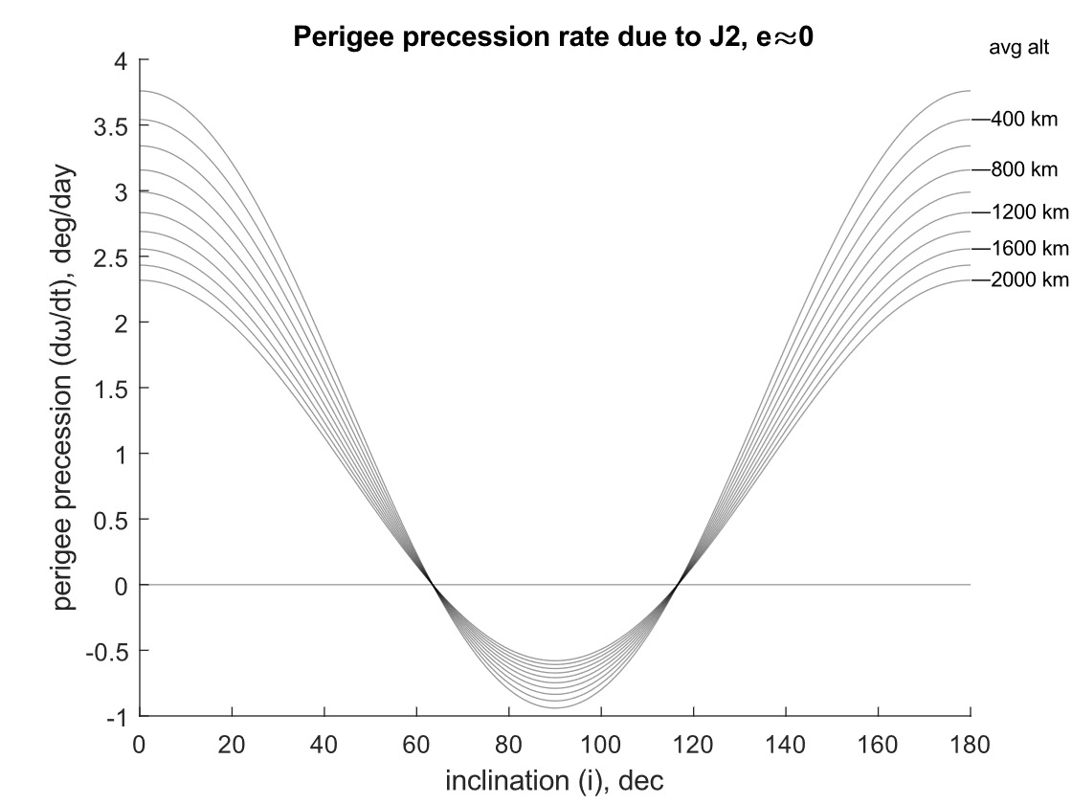
Variation: zero line

Slide 18
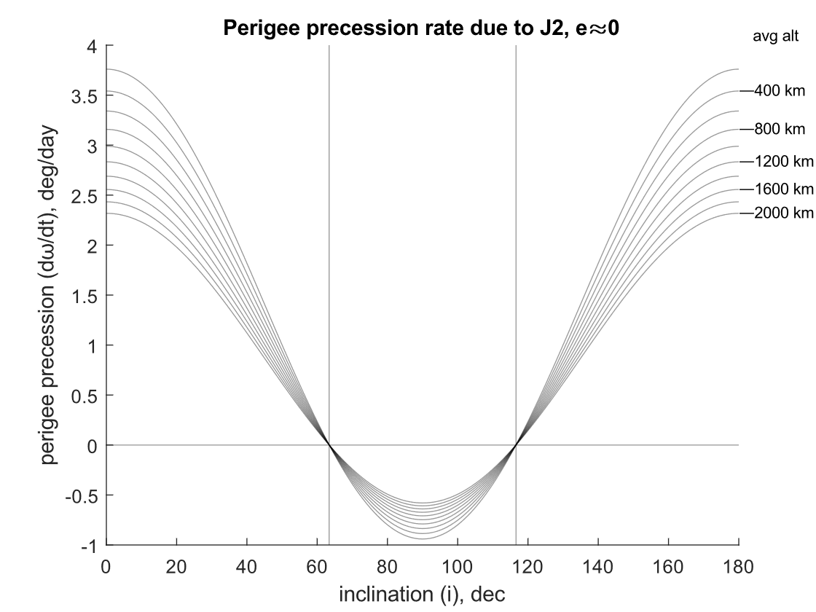
Variation: zero lines

Slide 19

Variation: grid
Usually unnecessary—reserve for when your readers need to actually read your plot rather than just understand it
Airplane TOLD data

Slide 20
Lessons: appearance
Don’t use thick lines
(Use points, not lines for discrete experimental data)
Use lines and avoid markers for smooth functions (including fit lines)
Include enough data resolution for smooth lines
Labels are better than legends
Don’t waste space
Don’t waste ink/attention
Remember red-green color blindness
Consider presentation (projector, printer)

Slide 21
Lessons: computer graphics
Use jpg only for photographs
Use vector graphics (svg, pdf) when possible
Otherwise use high-resolution bitmap graphics (gif, png)

Slide 22
Our bad graphs

Slide 23
ω
Molniya Orbit (63.4º)
Data represents a constant perigee value of 100 km and various apogee altitudes, as shown.

Slide 24
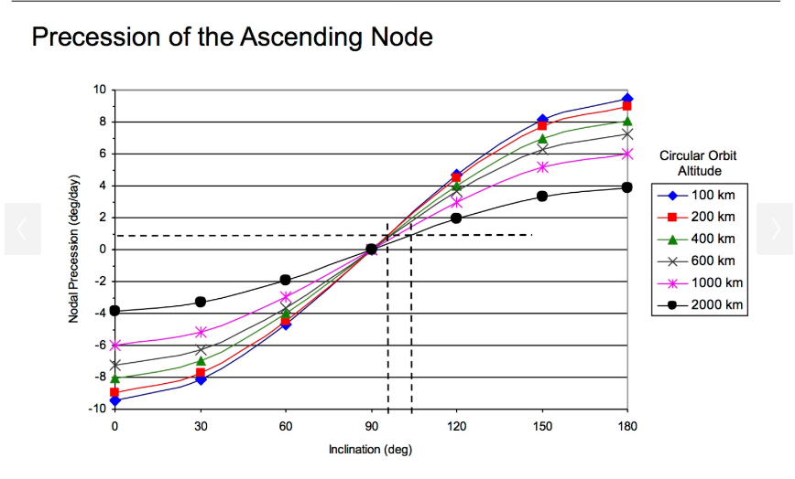
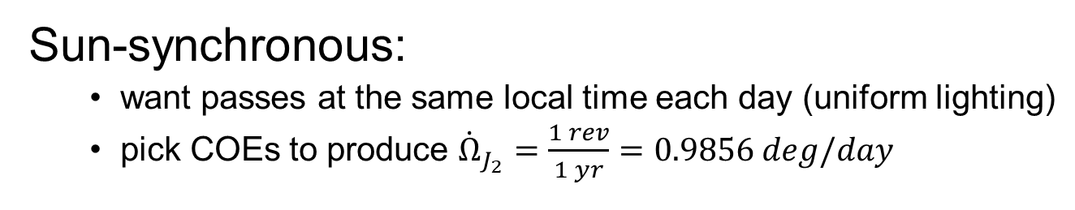
Sun-synchronous:
want passes at the same local time each day (uniform lighting)
pick COEs to produce ${\dot{Ω}}_{J_{2}}=\frac{1 rev}{1 yr}=0.9856 deg/day$

Slide 25
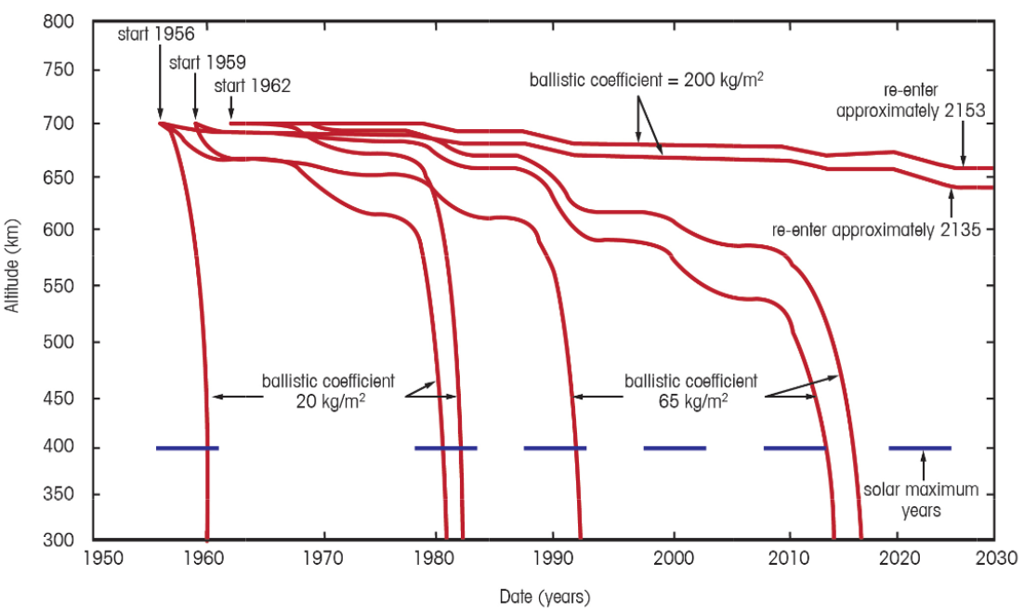
Hypothetical S/C Lifetimes
1962; BC = 200
1956; BC = 200
solar maximum years
1956
BC = 20
1959
BC = 20
1962
BC = 20
1956
BC = 65
1959
BC = 65
1962
BC = 65
adapted from Designing Space Missions and Systems, Fig 8.2

Slide 26
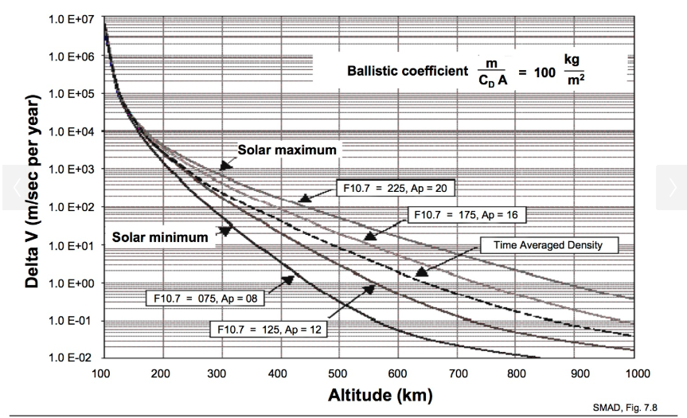
Altitude Maintenance ΔVs for a Ballistic Coefficient of 100 kg/m²

Slide 27
Some good graphs!

Slide 28
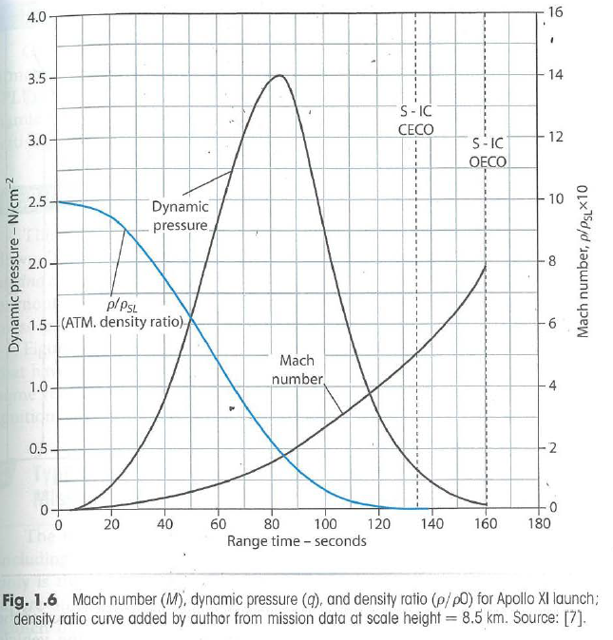
Scanning and compression badness is all mine

Slide 29
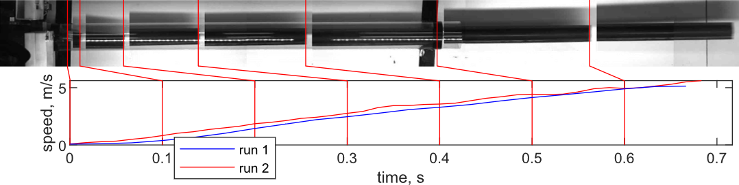
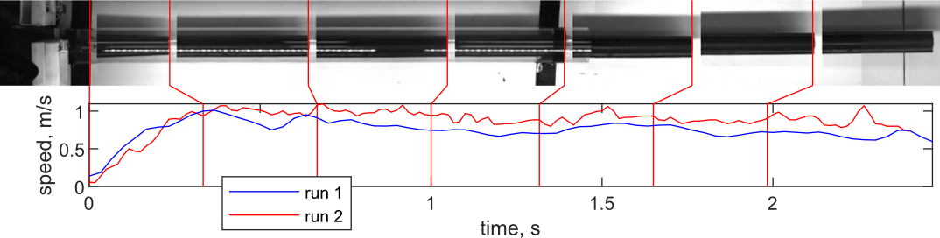

Slide 30
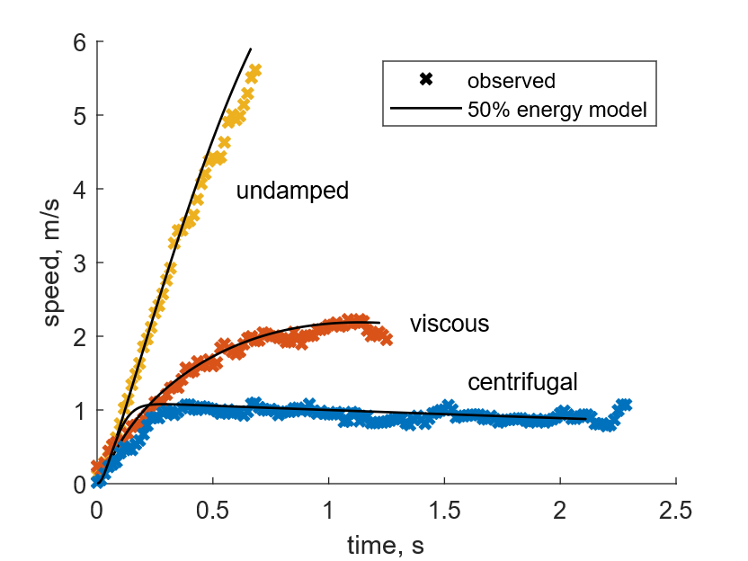
Markers
Colors
Labels

Slide 31
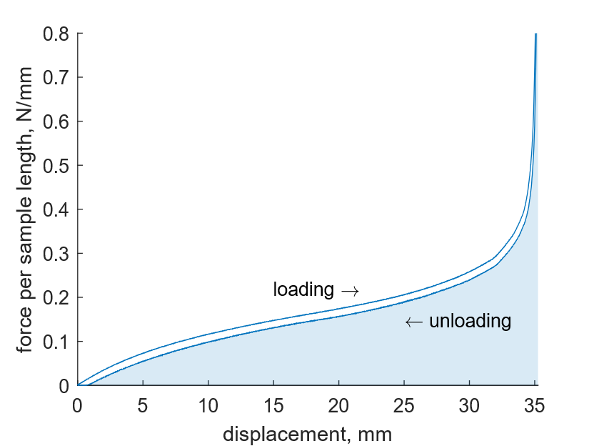
Shading can represent regions or integrals

Slide 32
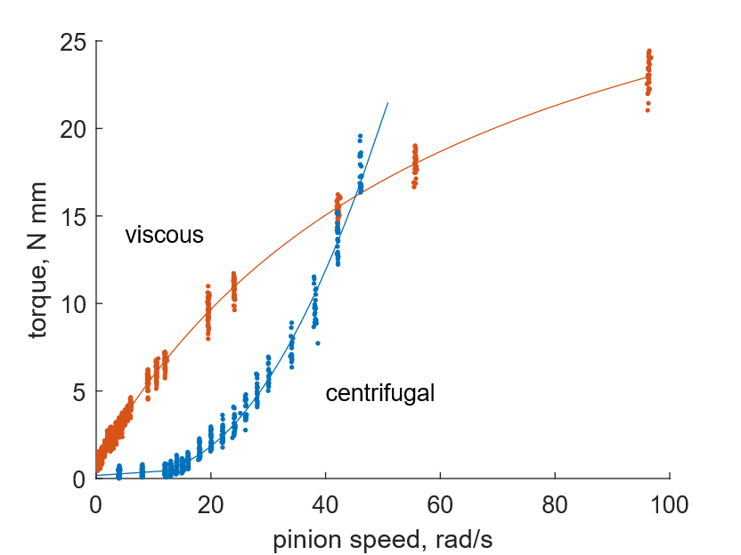

Slide 33
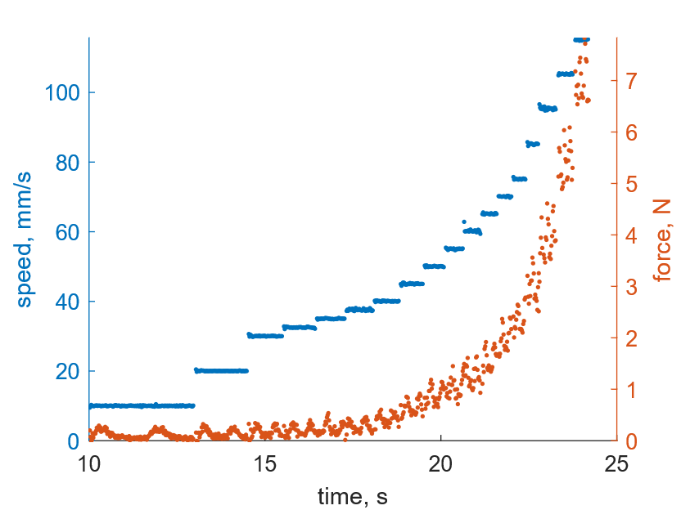
Axis color serves as legend for two data sets

